Slide 1
Building a Better 3D Model
And Interrogating it for a Better Design
Kevin Martin, KYTC
Jason Littleton, AEI

Slide 2
3D models have great value in construction
3D models have just as great a value in design!
3D Models for Design (and maybe Construction)
Notes:
We have heard countless times over the past decade about the value of a 3D model for the construction engineer. And no doubt, there is great value in that arena. The construction industry has taken the lead on 3D modeling because they see the benefits to them as it relates to time, money and safety. 3D models help expedite the construction process through the use of automated machine guidance (AMG) because it all but eliminates the need for construction staking. And with less time required to complete the same task, the contractor becomes more efficient and profitable. With more emphasis on the machine and less on the worker, the worksite becomes safer by removing workers from dangerous positions.
BUT…3D models can benefit the designer just as much as the contractor. If design cost is 10% of the construction cost, then putting forth a fraction more effort to create a detailed 3D model has the potential to save much more when the project gets to construction by catching design errors before they get to construction. And it doesn’t end there; putting a little more time and effort into creating a detailed 3D model upfront will save time (and therefore money) when it comes time to produce the plans.

Slide 3
Better models begin with the template
Feature Name/Component Name Overrides
Create continuous features/components
Parametric Constraints
It Begins with the Template
Notes:
The secret to making your job easier when creating a detailed 3D model lies in the templates from which it is created. If you put in the time to build your templates thinking of how they will be used in the next step, you will save yourself countless time and headaches.
Some tips on templates are to use the Feature name and component name overrides. What feature name overrides do is create a single feature from multiple template points (think about different fill/cut slopes or ditch bottoms) when the surface is created. There are similar capabilities in creating continuous components. Using component name overrides will create components with the same name from different template components. This will help when harvesting quantities from or, simply, viewing components for visualization purposes.

Slide 4
Parametric Constraints allow you to:
Widen/Narrow lanes for lane additions/drops
Widen shoulders for guardrail end treatments
Adjust side slopes to transition smoothly
Adjust pavement depths on-the-fly
Parametric Constraints
Notes:
My favorite part of each template is the parametric constraints/labels. If you take the time to assign parametric labels to point constraints in your template, it will more than pay off when you get to creating your model. You can assign labels to almost any constraint so that those constraints can be adjusted in Roadway Designer. You can taper lane widths, widen shoulder for guardrail, transition fill/cut slopes with these constraints. The possibilities are numerous!

Slide 5
DEMO
Building a Better 3D Model
Notes:
In the Template Library, show the 3-Ln-TWLTL template and the amount of parametric labels assigned.
In Roadway Designer, cover adding a turn lane, transitioning slopes, adjusting pavement depths.

Slide 6
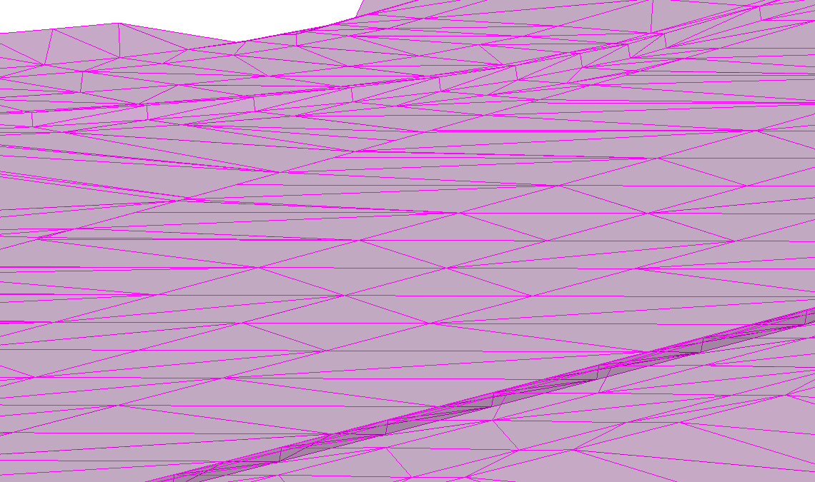
View PR triangles and use smooth (or transparent) shading to quickly render the model.
Surface>View Surface>Options to vertically exaggerate surface features
1x
5x
Use 3D Rotated Views to Find Busts
Notes:
A lot of discussion in the past has been devoted to how to create a detailed 3D model—and with good reason. However, there has been very little discussion regarding how to check the model for errors. One of the quickest ways to find potential errors in the model is to utilize 3D views in MicroStation. Just view the triangles from your model, switch your display style to “smooth” and rotate around the 3D view to see if you find any spikes. Zoom into different areas and at different angles to get different perspectives.
There is also an option in InRoads to vertically exaggerate your DTM. In InRoads, go to Surface>View Surface>Options and play around with the vertical exaggeration. In this example, you just can tell there is a slight bump in the radius when viewed at a 5x exaggeration. The same bump is almost unnoticeable when not vertical exaggerated. That bump is on the order of 0.07’, not much and probably not significant but it could be.

Slide 7
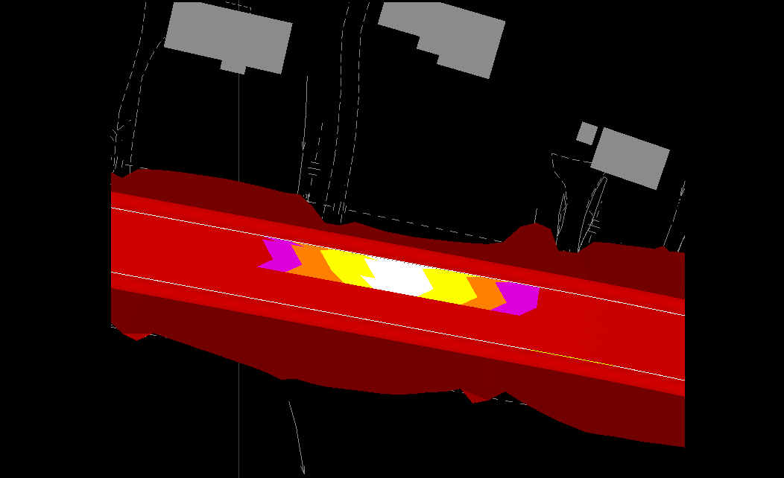
Surface>View Surface>Color Coded Slopes to view triangles with colors based on slope
Find Flat Areas/Steep Areas quickly
Notes:
Another handy tool to check your design in InRoads is to view the color coded slopes. This tool doesn’t just help your model, it helps your design. It gives you a quick visual representation of the vector slope of each triangle. Using the “Smooth” display style in MicroStation, you can quickly spot flat spots in your model. Even though the horizontal alignment and vertical alignment and superelevation transitions may all meet geometric standards individually, the combination of them may pose issues such as this flat spot caused by the combination of a flat vertical grade entering a horizontal curve. To view the color codes slopes, go to Surface>View Surface>Color Coded Slopes.

Slide 8
Color Coded Slopes
Notes:
This image has been included here so you can see the settings if you wanted to use color coded slopes as this preference has not yet been incorporated in the KYTC CADD Standards XIN file.

Slide 9
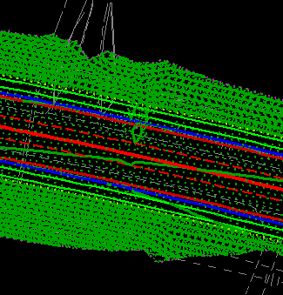
Use contours viewed at tight intervals (0.1’-0.2’) to quickly catch busts.
Pay particular attention to areas that aren’t “typical”
Find the “Small” Busts
Notes:
Probably one of the easiest ways to verify a 3D model does not have busts would be to view the proposed contours for the model. If you cut the contours at a tight interval, even small errors will present themselves. In this example, the contours were viewed at 0.1’ intervals to catch this area where the superelevation had an issue. I like to turn off the contour labels because at this point, I’m not concerned about the actual elevation, but, rather, I am concerned that the contours run approximately parallel to one another.

Slide 10
DEMO
Quality Assurance
Notes:
View the proposed triangles for the model and use MicroStation commands to rotate around the DGN to look at different areas. Show how to vertically exaggerate the surface data. View color coded slopes and tight contours to show what you want to see and what you want to look out for.

Slide 11
Hand-editing cross sections is very time consuming
Making changes in the model decreases the effort needed to manipulate sections.
Designer can view GR, DT, EP features in cross sections to place GR cell and annotate DT, EP elevations
BUT a detailed model doesn’t mean cross sections don’t need detail. Plans (and sections) are still the legal document.
Manipulating Cross Sections
Notes:
The purpose of a detailed 3D model, from a designer’s perspective, should be to put out a better final product. If construction chooses to use it then great! If not, it has still proven beneficial by catching errors before they got out the door. The 3D model also helps the designer decrease drafting effort. Hand editing cross sections is very time consuming. And the vast majority of cross section manipulations can be addressed in the model with much less effort. For instance, KYTC would like to see edge of pavement and ditch elevations on the cross sections. By viewing those crossing features on the cross section, you can annotate them at once instead of having a draftsperson place each elevation individually. Same thing with any guardrail—if it’s in the model, you can view it on the cross section with the proper cell.
But this does not release us, as designers, from our duty to make sure the cross sections are properly detailed. The model cannot detail the cross sections to the degree necessary, but it can help lighten the workload. We have to remember that for the time being, the plans and cross sections (PDF) are still the document that contractors are legally obligated to construct.

Slide 12
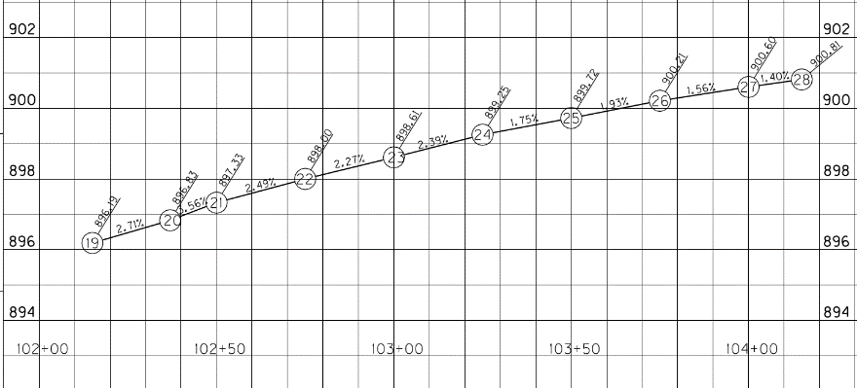
Use drafting notes to pull information from the 3D model.
Speeds drafting time and decreases human error.
Pavement Development Sheets
Notes:
Use InRoads drafting notes to make quick work of time consuming tasks such as pavement development sheets. The drafting notes have the capability of pulling the elevation of a point on the model and presenting on the screen for placement. These tools help speed drafting time and reduce the potential for human error such as mis-typing the elevation.

Slide 13
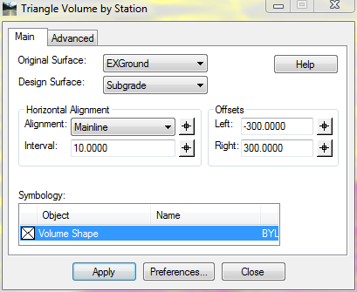
Traditional end area volumes calculated every 50’.
Triangle volumes calculate difference between existing/proposed models
Evaluation>Volumes>Triangle Volume by Station
Earthwork Volumes
Notes:
Having a detailed 3D model also helps provide more accurate earthwork volumes. The traditional end area volume method has the potential to miss valleys or ridges in the existing ground that occur between cross sections. InRoads can report volumes as differences between the existing and proposed surface triangles. You can do the entire surface or have the volumes reported by station to more closely mimic what users are used to seeing from the end area volume method. It’s important to note that any triangle volumes need to be calculated to a subgrade surface as this method does not remove component areas like the end area volume method. This tool can be found under Evaluation>Volumes>Triangle Volume by Station. Set the interval at which you want to have the volumes reported and make sure your offsets fall outside your furthest limit so that the entire surface is encompassed.

Slide 14
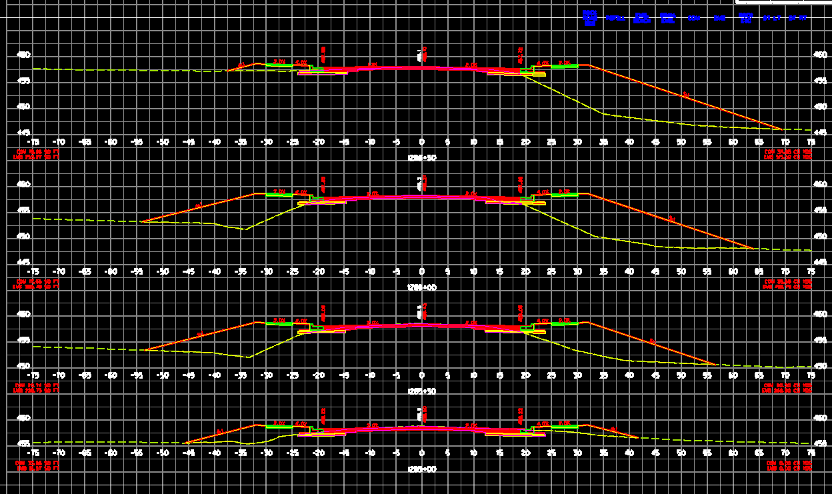
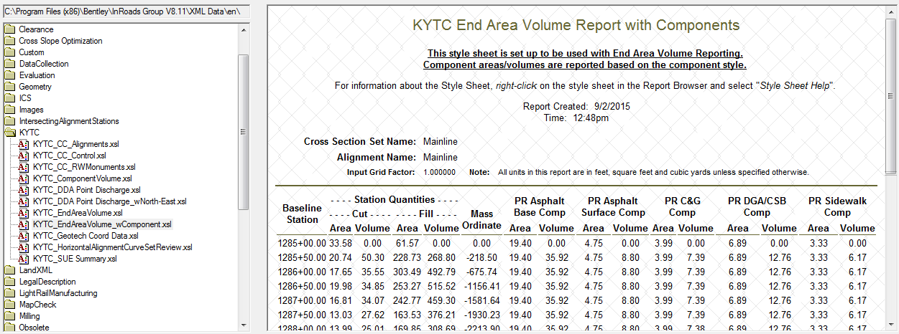
InRoads Earthwork Volumes
Notes:
This will generate an XML report that can be exported to Microsoft Excel just like is available from the End Area Volume method. Be sure when using the Triangle Volume by Station method to use the Evaluation>Basic Volume report. If you aren’t getting any display from your XML report, toggle through other reports to see if another will get you results.

Slide 15
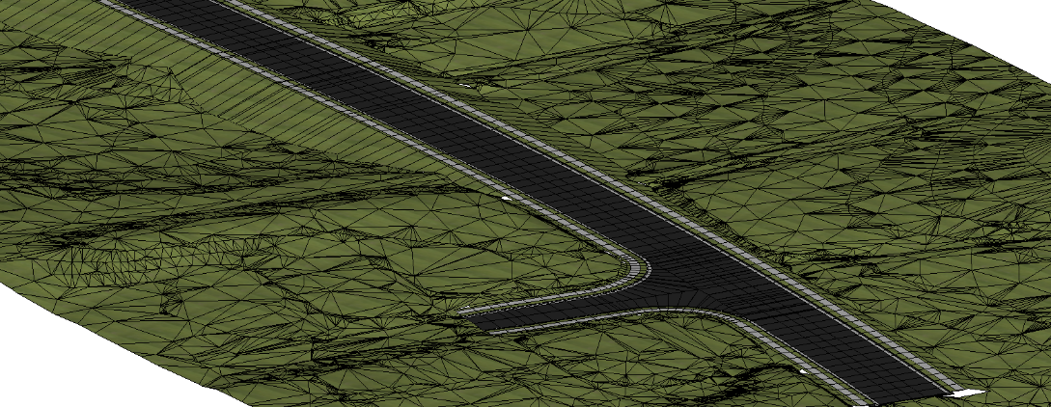
View paving components in 3D and use MicroStation measure tool to find volume.
Toggle on “Stitch Mesh Faces”
Harvesting Quantities from Components
Notes:
As models become more developed, we begin to enter into a position where we can view the model components in 3D and use the MicroStation measure tools to determine component quantities such as for asphalt surfacing, different asphalt base layers, aggregate, etc. To be able to use the measure tools, you need to make sure to check the “Stitch Mesh Faces” check box. And who is to say that we couldn’t begin to associate a unit cost to those components to get preliminary estimates?

Slide 16
Detailed 3D models open the door to begin utilizing clash detection in MicroStation.
Find clashes with proposed storm sewer or existing utilities with SUE “Level A” data.
Clash Detection
Notes:
And as things being to become even more detailed, things such as Clash Detection begin to become a real possibility. In the SUDA product (the new InRoads S&S available in SS3), a 3D model of the network is generated as MicroStation solids. The designer can then use these solids to detect clashed between storm sewers and cross drains. Or if detailed utility information is available (SUE Quality Level A), then clash detection can be done against the existing utilities.

Slide 17
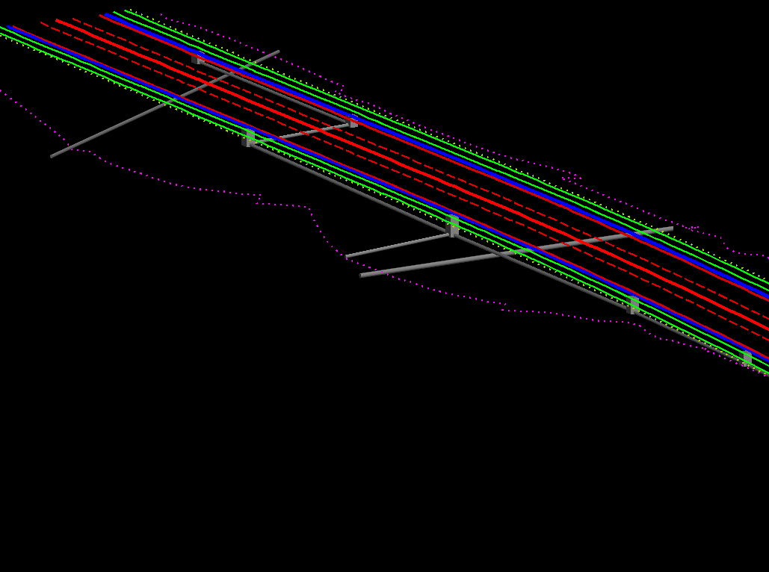
Clash Detection

Slide 18
DEMO
Benefits of more detailed 3D Models
Notes:
Show how InRoads Drafting Notes can pull information directly from the model. Show how to calculate triangle volumes by station. View components in 3D and use the MicroStation tools to measure their volumes.

Slide 19
Build the template properly.
Use parametric constraints to handle transitions quickly.
View model in 3D and rotate to find busts.
Or view tight contours to find busts.
View color coded slopes to find flat spots.
Focus on areas that aren’t “typical”.
Don’t worry about ADA ramps & headwalls for now unless there’s a need.
The goal is a better design and the benefits are numerous!
Notes:
In summary, if you build your template well, your modeling task will be a breeze! Take advantage of the parametric constraints available to bridge the template library and roadway designer. Take the time to interrogate your 3D surface using the various commands available through MicroStation and Inroads. While looking at your model take extra time to look at areas that aren’t typical—areas of transitions, lane drops and additions, guardrail widening and intersections. Don’t worry about small items like ADA ramps and headwalls at this point. Right now, we need to focus on the big picture. There may be isolated instances where these items may need to be modeled and they’re probably better modeled as MicroStation solids and brought into the DTM if necessary.
The goal is to put out a better product and the benefits of investing a little extra time are numerous!

Slide 20
THANK YOU! QUESTIONS?

Slide 21
KYTC Design Webinars
http://transportation.ky.gov/Highway-Design/Pages/Software-and-Support.aspx
Template Creation
https://www.youtube.com/watch?v=pAVbAIMFTxE&feature=youtu.be
Modeling Radii
https://www.youtube.com/watch?v=KiX6SKkA29Q&feature=youtu.be
FHWA Resources
www.fhwa.dot.gov/3d
Web based training
http://www.fhwa.dot.gov/construction/3d/wbt.cfm
3D Resources

